Slide 1

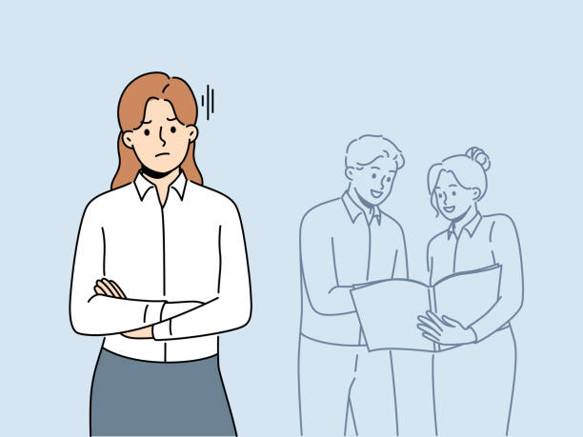
Project Proposal "Monopolizing Conversations: Examining Developer Conversation Participation in Chat Applications"
Shane Ellis
Nathan Stechschulte

Slide 2

Literature Review: Done So Far (1)
"DISCO: A Dataset of Discord Chat Conversations for Software Engineering Research"
https://dl-acm-org.leo.lib.unomaha.edu/doi/10.1145/3524842.3528018
Similar related works, including those from authors, explored Slack, IRC, Gitter, Teams
Data collection from four software developer Discord communities
Python, Go, Clojure, and Racket communities
Approximately 11 months of data from Nov. 2019 – Sep./Oct. 2020
JSON files converted to XML format; private information anonymized
Chat disentanglement technique applied to manual sample of 500 conversations
Identify relevant discussions among the noise of other conversations or messages, F-score of 0.79
Disentanglement method created from past research outings covering other chat applications
LDA Topic modeling used
Top five discussion topics from each community identified
Author stated dataset implications:
Guidance analysis, chatbot ML technique analysis, following chat evolution
S

Slide 3



Literature Review: Done So Far (2)
"On the Helpfulness of Answering Developer Questions on Discord with Similar Conversations and Posts from the Past"
https://dl-acm-org.leo.lib.unomaha.edu/doi/10.1145/3597503.3623341
Discord chat platform
Repeated questions
Approach to automatically identifying the repeated questions
Found
40% found suggestion of repeated questions helpful
Suggesting Stack Overflow is more helpful vs prior Discord question
Suggests developers have difficulties describing their problems as search queries vs natural language questions online
N

Slide 4



Literature Review: Done So Far (3)
"Software-related Slack Chats with Disentangled Conversations"
https://dl-acm-org.leo.lib.unomaha.edu/doi/10.1145/3379597.3387493
https://zenodo.org/record/3627124
Data collection from three software developer Slack communities
Python, Clojure, Elm (two channels)
Two years of data from Jun. 2017 – 2019
Similar approach to initial interest paper/dataset
XML data converted from JSON
Chat disentanglement technique applied
Built upon existing method, modified by authors
Same technique to be adapted for use with Discord dataset
F-score of 0.80, 0.66 with original method
Metrics Observed
Conversation length, code snippet count, code snippet length
Typical range of 5-7 sentence conversations
Code snippets less frequent/smaller in size
More popular on Elm, less so for Python
S

Slide 5


Literature Review: Done So Far (4)
"Perceptions on the Utility of Community Question and Answer Websites Like Stack Overflow to Software Developers"
https://ieeexplore-ieee-org.leo.lib.unomaha.edu/document/9941729
Paper talks about software going from solo activity to massive ecosystems
"Participatory culture" encourages developers to interact
Many platforms exist now: Stack Overflow, Reddit, Quora (mentioned in this paper)
Collaborative channels
"Community Question and Answer" (CQA) platforms
Paper could give insights to nature of developer interactions and comparing CQA platforms with other platform types
N

Slide 6


Literature Review: Done So Far (5)
"Imposter Phenomenon in Software Engineers"
https://dl-acm-org.leo.lib.unomaha.edu/doi/10.1145/3639475.3640114
Two Research Questions:
"How does IP manifest in software engineers?"
"Does IP affect the perceived productivity of software engineers?"
Derivation: "Does IP affect Communication and Collaboration?"
Survey conducted
624 participants, 26 countries, 100 companies
"52.72% of software engineers suffer from frequent to intense levels of IP"
Higher percentages observed among women and minorities
Focus on communication and collaboration examined
Individual participant role perception within teams
Inter-team communication
Results specifically focusing on communication showed a lower productivity
Larger percentages of disagreements with respect to imposter phenomenon
S

Slide 7

Literature Review: Gaps
Public chat channels have different etiquette then other platforms
Single threaded channel
Rapidly moving
Attention span is shorter
Noticed pattern of interactions between individuals:
If two individuals (or a small group) go back and forth in a conversation, the less likely someone else will feel welcoming "joining" a conversation
S

Slide 8


Literature Review: How Can Solve
Idea: Measure the interactions between users
Measure how long two individuals reply to each other before another person "joins" the conversation
Understand if there's a detectable "point" in conversations
N

Slide 9


Research Questions
Is there a measurable difference to how long conversations in a public channel go on between a limited group before a new individual adds to it?
Do the number of posts present in a conversation effect prospective participants?
Does the length of a message impact who replies?
Can the health of a public message channel be measured by chat interaction patterns?
S

Slide 10


Data Collection
Reusing of existing data collected!
Reference #1
28k conversations
1.5 million messages
323k users
Reference Dataset
https://zenodo.org/record/5909202
NOTE: Additional literature may have additional datasets that are applicable to our research (time pending)
S

Slide 11
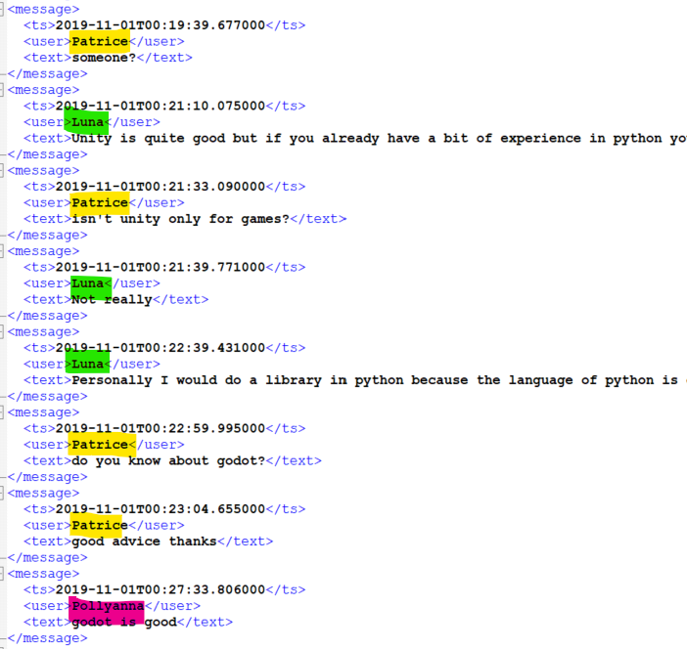
Data Collection
Existing data from reference literature
Found pattern of back and forth
Gap between others got involved
4 minutes
4 minutes

Slide 12

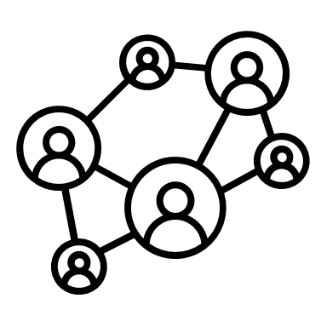


Analysis
Quantitative approach (analyzing existing data)
Track the transitions between users in a conversation
If conversation goes between two users "too long"
Either through # of interactions or duration (time)
Measure the probability of someone else joining the conversation
N

Slide 13
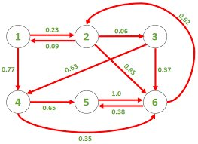
Analysis
Could try to model the conversations using Markov Chain approach
Given interactions between individuals, probability someone else will reply
State = Individual
Transition = Next Person to Reply
"If Bob messages, what is the likelihood
of whom would be the next to reply?"
N

Slide 14
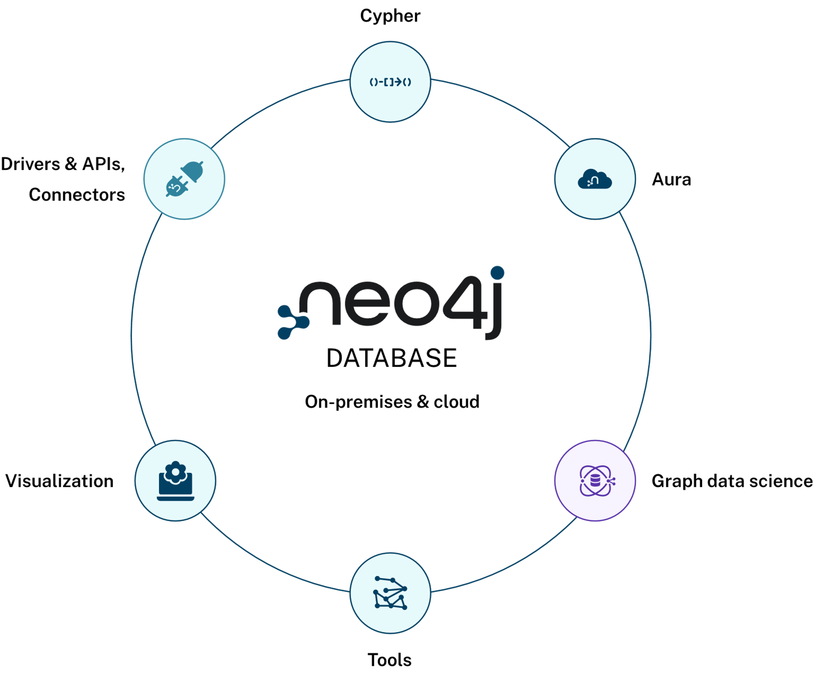
Tools Options
Build a tool ourselves to analyze data
Neo4j - Graph based database system
Disentanglement Technique Algorithm
Look into researcher algorithm
Original algorithm by Elsner and Charniak
Other data analysis tools – Markov Chain Analysis
S

Slide 15
Expected Outcome & Implications
See if there is correlation between extended singular conversations in public chats and observe their impact on the "health" of a public forum
See if we could detect when individuals are "monopolizing" conversations
Bonus / Further Research: Options to Address
"nudge" participants to take it to another method of private conversation
Give participants a "cool down" before replying
Alert others being left out
Use ChatGPT to summarize back and forth and prompt others to be included
S

